Slide 1
Software Quality Assurance
Pavithra Subashini
Senior lecturer
Faculty of Computing

Slide 2
Test case is defined as
A set of test inputs, execution conditions and expected results, developed for a particular objective.
Documentation specifying inputs, predicted results and a set of execution conditions for a test item.
Specific inputs that will be tried and the procedures that will be followed when the software tested.
Sequence of one or more subtests executed as a sequence as the outcome and/or final state of one subtests is the input and/or initial state of the next.
Specifies the pretest state of the AUT and its environment, the test inputs or conditions.
The expected result specifies what the AUT should produce from the
test inputs.

Slide 3
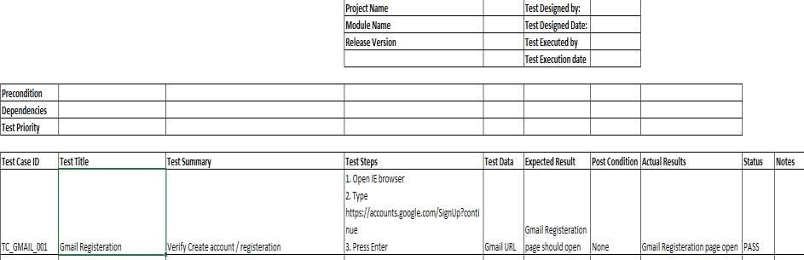
Test Cases
Test Case ID
Test Title
Test Summary/ Objective/ Description
Test Case Steps
Test Data
Expected result
Post Condition
Actual result
Status / Pass/fail
Notes /Comments

Slide 4
Good Test Cases
Find Defects
Have high probability of finding a new defect.
Unambiguous tangible result that can be inspected.
Repeatable and predictable
Traceable to requirements or design documents
Push systems to its limits
Execution and tracking can be automated
Do not mislead
Feasible

Slide 5
Test Case Design Technique
Black-box testing (or functional testing):
Equivalence partitioning
Boundary value analysis
Cause-effect graphing
Behavioural testing
Random testing

Slide 6
Black-box: Three major approaches
Analysis of the input/output domain of the program:
Leads to a logical partitioning of the input/output domain into ‘interesting’ subsets
Analysis of the observable black-box behavior:
Leads to a flow-graph-like model, which enables application of techniques from the white-box world (on the black-box model)
Techniques like risk analysis, random input, stress testing

Slide 7
Black-box : Equivalence Partitioning
Equivalence Partitioning also called as equivalence class partitioning. It is abbreviated as ECP. It is a software testing technique that divides the input test data of the application under test into each partition at least once of equivalent data from which test cases can be derived.
An advantage of this approach is it reduces the time required for performing testing of a software due to less number of test cases.

Slide 8
Black-box : Equivalence Partitioning
Example:
If one application is accepting input range from 1 to 100, using equivalence class we can divide inputs into the classes, for example, one for valid input and another for invalid input and design one test case from each class.
In this example test cases are chosen as below:
One is for valid input class i.e. selects any value from input between ranges 1 to
100. So here we are not writing hundreds of test cases for each value. Any one
value from this equivalence class should give you the same result.
One is for invalid data below lower limit i.e. any one value below 1.
One is for invalid data above upper limit i.e. any value above 100.

Slide 9
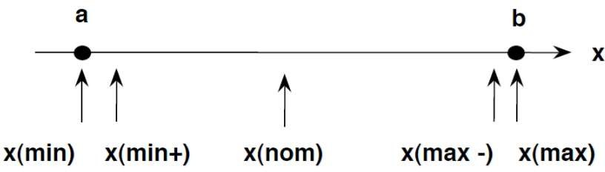
Boundary value analysis
Boundary value analysis is a type of black box or specification based testing technique in which tests are performed using the boundary values.
Boundary Testing comes after the Equivalence Class Partitioning.
Testing between extreme ends or boundaries between partitions of the input values.
Example:
Input data 1 to 10 (boundary value) Test input data 0, 1, 2 to 9, 10, 11

Slide 10
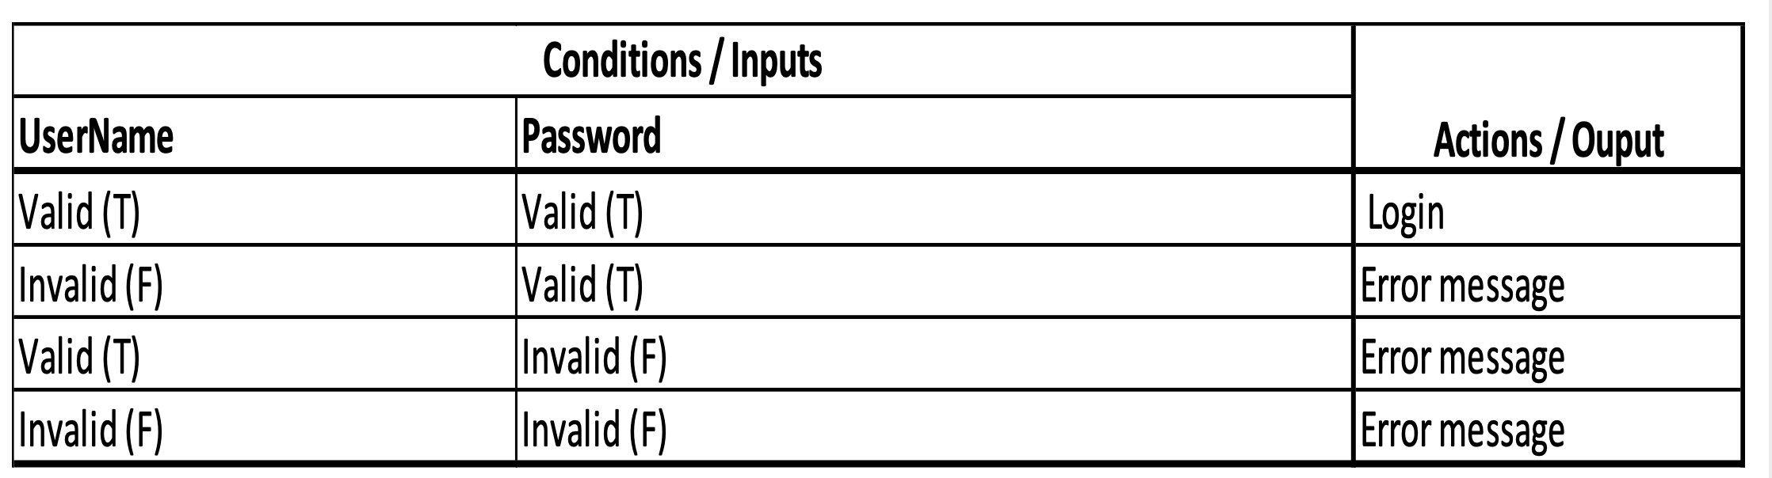
Decision Table
A decision table is a good way to deal with combinations of Inputs
Also referred as cause- effect table
Focused on business logic or business rules
Decision tables provide a systematic way of stating complex business rules,
Note:- Number of possible Combinations is given by 2 ^ n , where n is the number of Inputs.
In the above example :- we would need 2 ^ 2 = 4 combinations

Slide 11
Decision Table
Advantages:-
It provide complete coverage of test cases which help to reduce the rework on writing test scenarios & test cases.
Any complex business flow can be easily converted into the test scenarios & test cases using this technique.
Simple to understand and everyone can use this method design the test
scenarios & test cases.
These tables guarantee that we consider every possible combination of condition values. This is known as its “completeness property”.

Slide 12
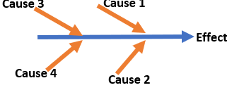
Cause Effect Graph
A “Cause” represents a distinct input condition that brings about an internal change in the system.
An “Effect” represents an output condition, a system transformation or a state resulting from a combination of causes.
It is also known as Ishikawa diagram as it was invented by Kaoru Ishikawa or
fish bone diagram because of the way it looks.
Circumstances - under which Cause-Effect Diagram used
To Identify the possible root causes, the reasons for a specific effect, problem, or outcome.
To Relate the interactions of the system among the factors affecting a
particular process or effect.
To Analyze the existing problems so that corrective action can be taken at the earliest.

Slide 13
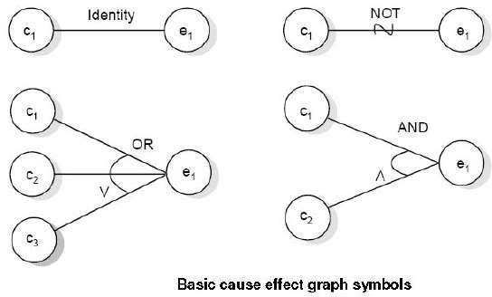
Benefits:
It Helps us to determine the root causes of a problem or quality using a structured approach.
It Uses an orderly, easy-to-read format to diagram cause-and-effect
relationships.
It Indicates possible causes of variation in a process.
It Identifies areas, where data should be collected for further study.
It Increases knowledge of the process by helping everyone to learn more
about the factors at work and how they relate.

Slide 14
Error Guessing
Make use of a tester’s skill intuition and experience in testing similar applications to identify defects that may not be easy to capture by the more formal techniques. It is usually done after more formal techniques are completed.
Mainly used during release of application
Usually used by the experts
Its less reproducible
Coverage is limited by experience, knowledge and time available
Types of defects depends on the scenarios that were guessed
Checklist based testing
Typical conditions to try include division by zero, blank (or no) input, empty files and the wrong kind of data (e.g. alphabetic characters where numeric are required).

Slide 15
Random Testing
What is Random Testing?
Random Testing, also known as monkey testing, is a form of functional black box testing that is performed when there is not enough time to
write and execute the tests.
Random Testing Characteristics:
Random testing is performed where the defects are NOT identified in regular intervals.
Random input is used to test the system's reliability and performance.
Saves time and effort than actual test efforts.
Other Testing methods cannot be used to.
Random Testing Steps:
Random Inputs are identified to be evaluated against the system.
Test Inputs are selected independently from test domain.
Tests are Executed using those random inputs.
Record the results and compare against the expected outcomes.
Reproduce/Replicate the issue and raise defects, fix and retest.

Slide 16
Items in test cases

Slide 17
Test Case ID
Test Description/Test case name
Prerequisite
Test Steps
Input Data
Expected Result
Actual Result
Status
Severity
Priority
Executed by
Comments

Slide 18
Project details
Project name
Module name
Created by
Created date
Reviewed by
Reviewed date

Slide 19
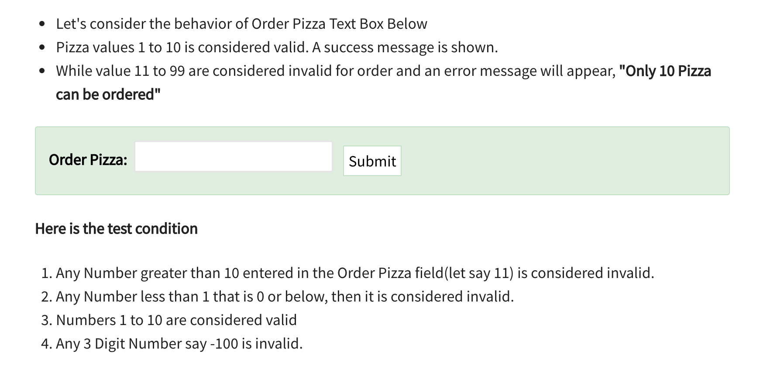
Sample 1

Slide 20
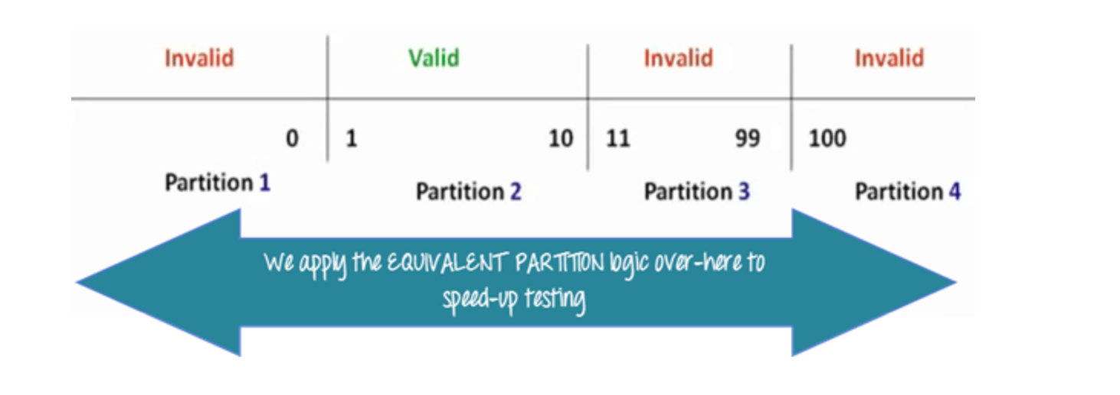
Equivalence Partitioning

Slide 21
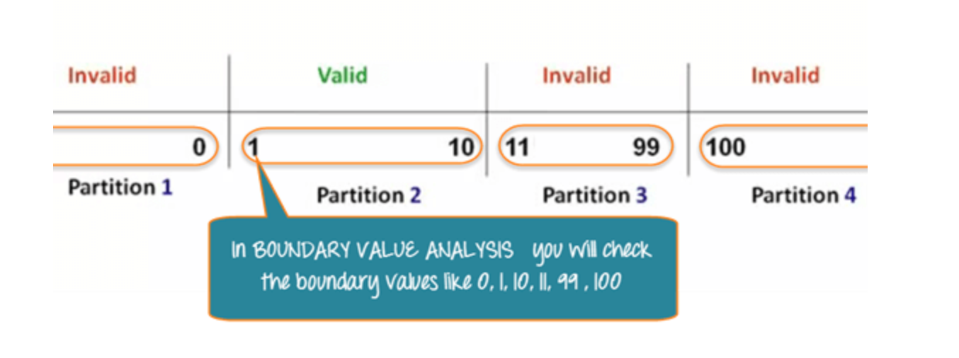
Boundary value analysis

Slide 22
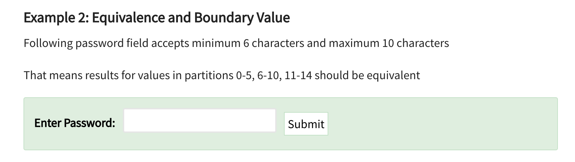
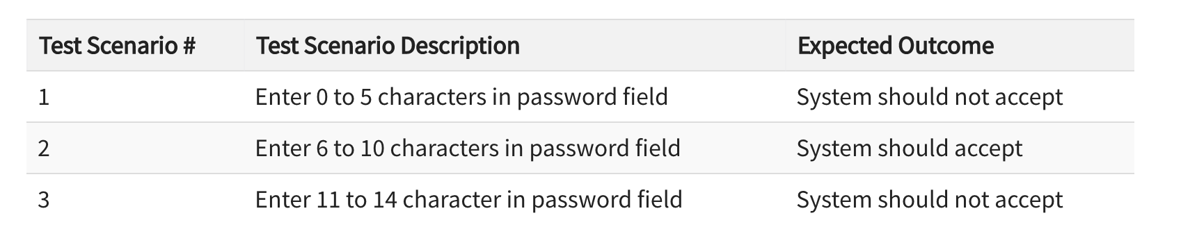

Slide 23
Open excel sheet Start test case writing

Slide 24
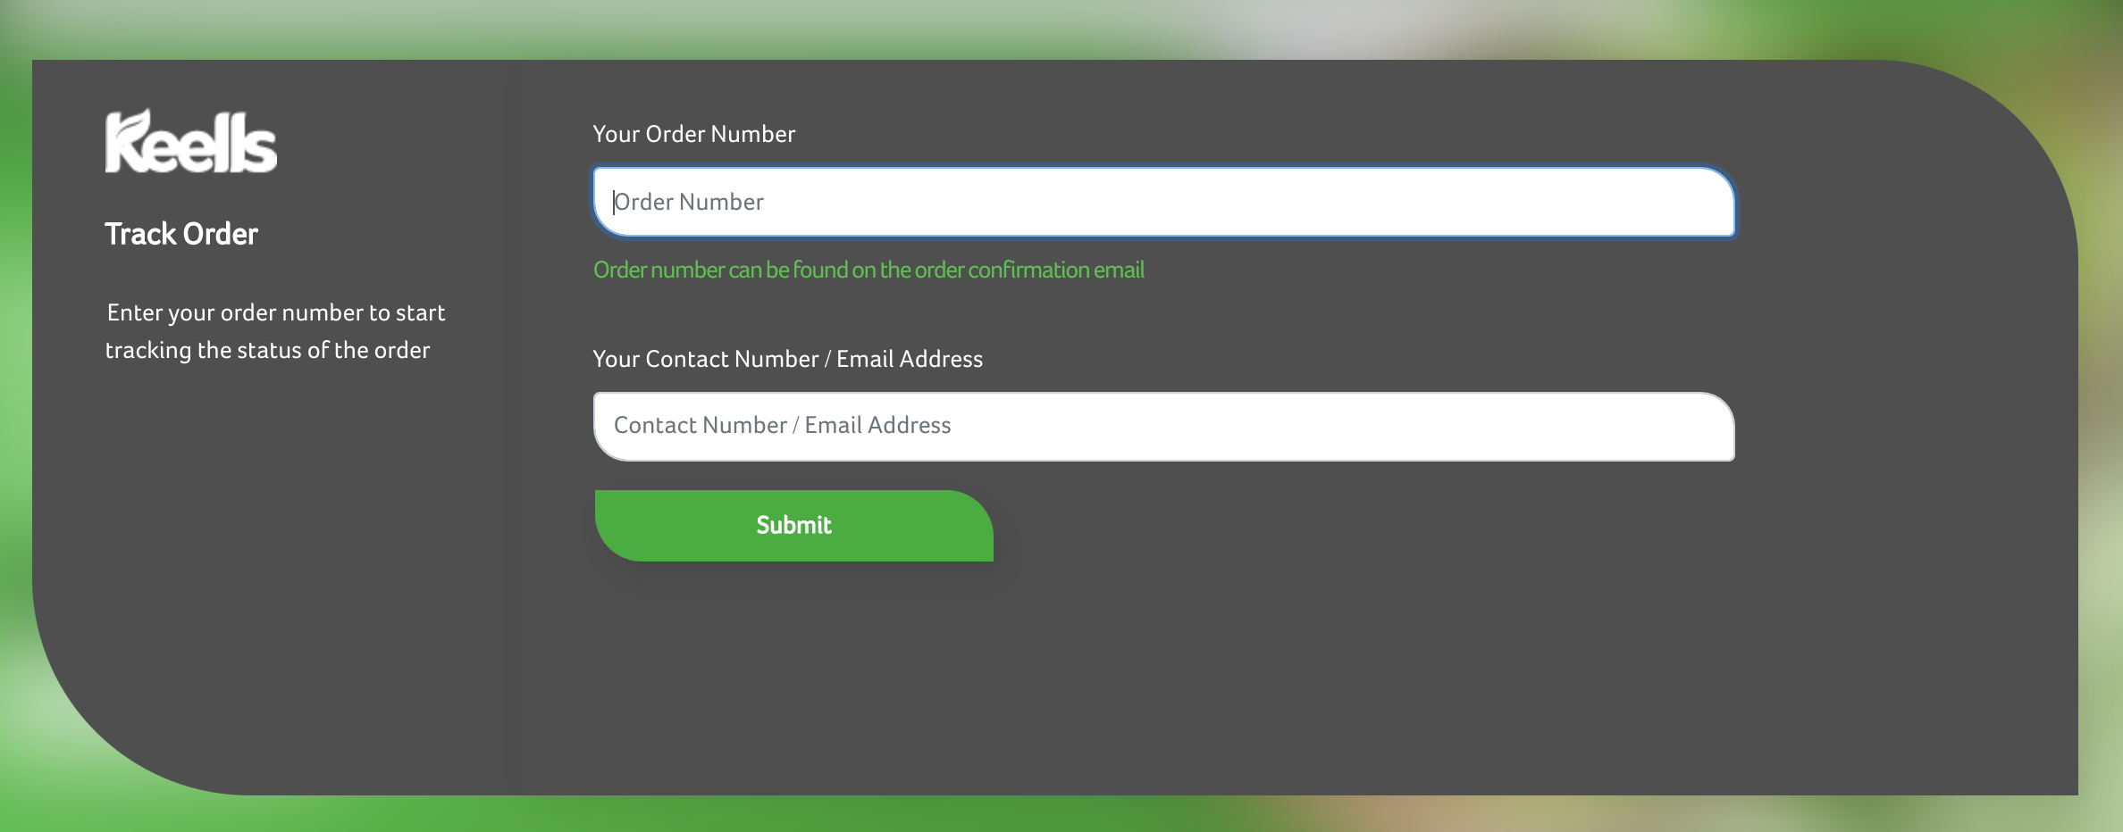
Activity
Write test cases to test below web page.

Slide 25



Slide 26


